Slide 1
End User Quick Guide Template
Make sure to customize this presentation based on the implemented scope.
Some topics that might differ :
  Are Zones and/or Departments configured?
  Are Confidential meetings set up for this environment?
  What are the settings with regards to icon decay on occupancy view?
  Include information / legends for the different available views

Slide 2


COBUNDU GO RESERVATIONS
END USER QUICK GUIDE

Slide 3

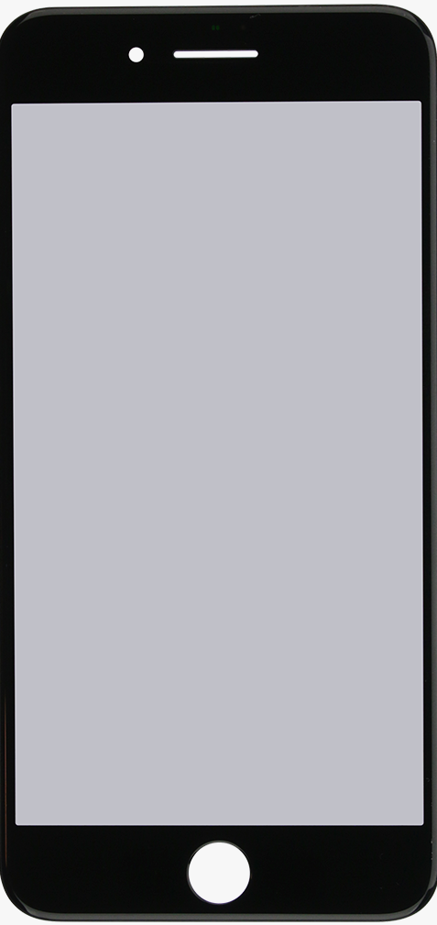

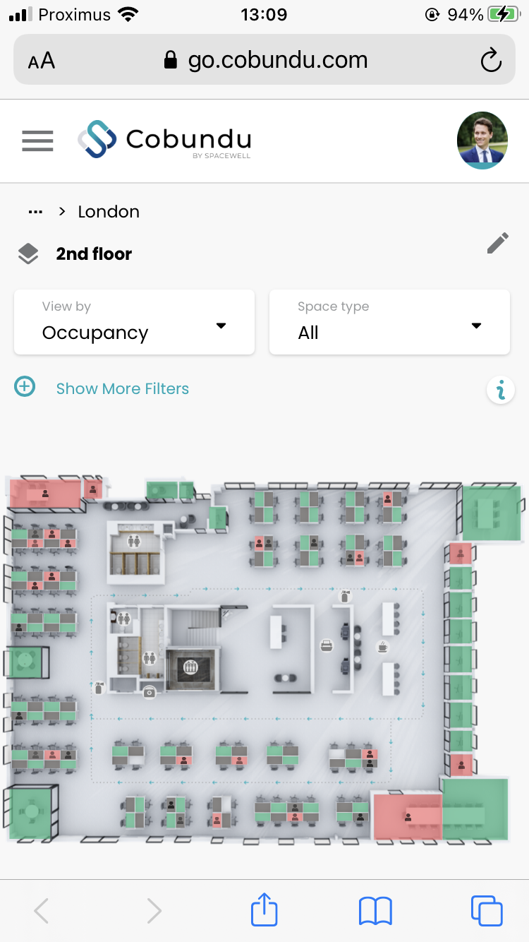
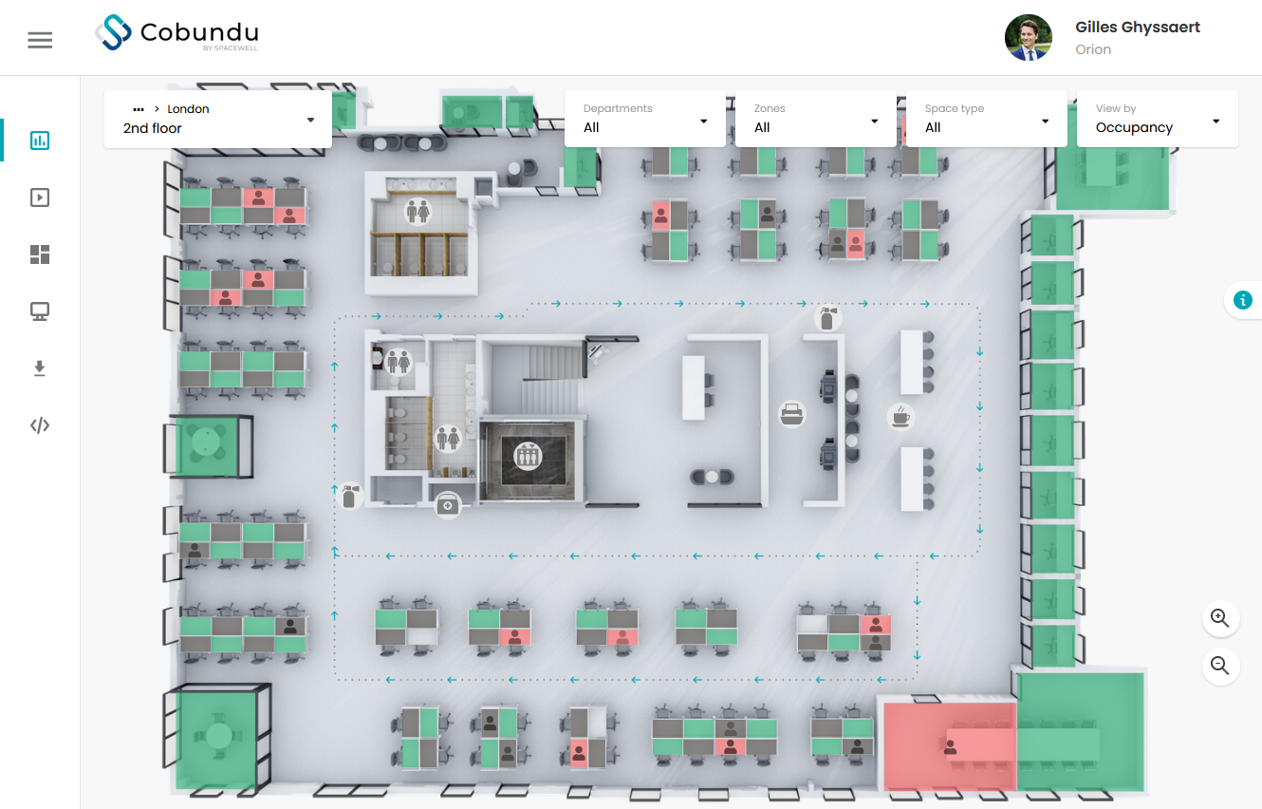

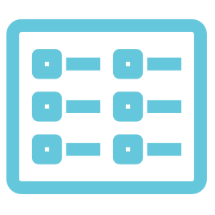

COBUNDU GO WEBPORTAL
BOOKINGS MADE EASY
Find and book rooms and desks through different functionalities that combine reservations and live occupancy data
VIEW DATA IN REAL TIME
The data is mapped intuitively on floor plans to show you immediate results at any moment
GET CONTEXTUAL INFO
Choose a room based on its equipment, capacity, comfort data
SYNC WITH OUTLOOK
Synchronize your bookings with Outlook

Slide 4
QUICK START GUIDE
In any of your prefered browsers, go to https://go.cobundu.com/
GO (features Live Floorplan, Replay & Dashboards) is optimized for mobile (only portrait orientation supported)
If SSO is set up for your environment
  Log in with your SSO user details. Cobundu will recognize SSO has been set up and log in automatically.
If SSO is not set up for your environment
  Log in with the provided log in details.
  Sessions are stored for a couple of days, so you might not have to log in every time to visit GO.
  After logging out, we’ll still remember your user name. You only need to provide your password.
  In case your forgot your password, Cobundu can send you a code to retrieve your login (if e-mail has been configured)

Slide 5
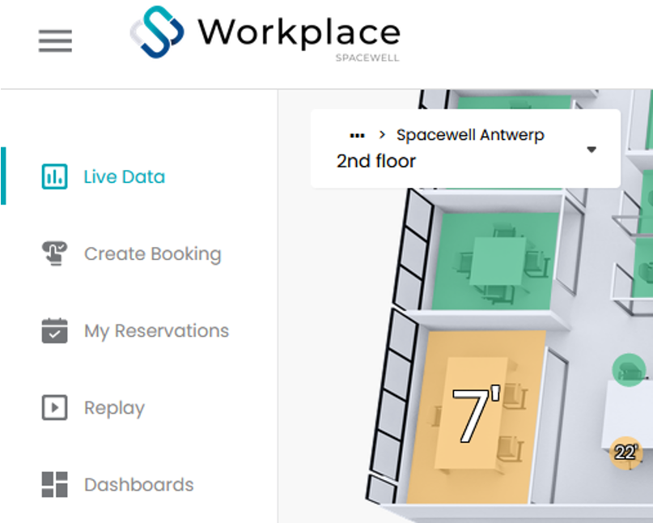
QUICK START GUIDE
Depending on your rights in GO, you might see following menu items:
  Live Data
    Check live sensor data
    Make reservations
  Create Booking
    Search relevant location and make reservation
  My Reservations
    Check your reservations
  Replay
    Replay sensor data values from the past
  Dashboards
    Look into sensor data values from the past
  Kiosk Mode
    Set up a kiosk for reservations

Slide 6

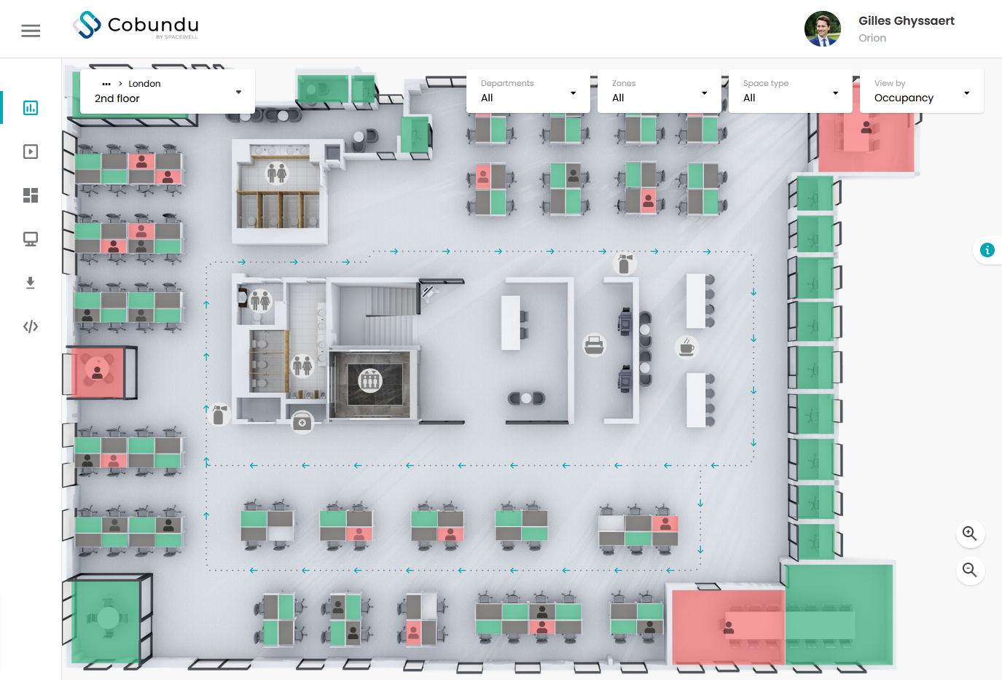
FUNCTIONALITY OVERVIEW
Filter on a specific department or zone
Toggle between different space types
View the different floorplan modes, depending on captured data
Select the relevant floor from the location tree
Open floorplan legend
Click on a desk/room to open the location detail screen

Slide 7
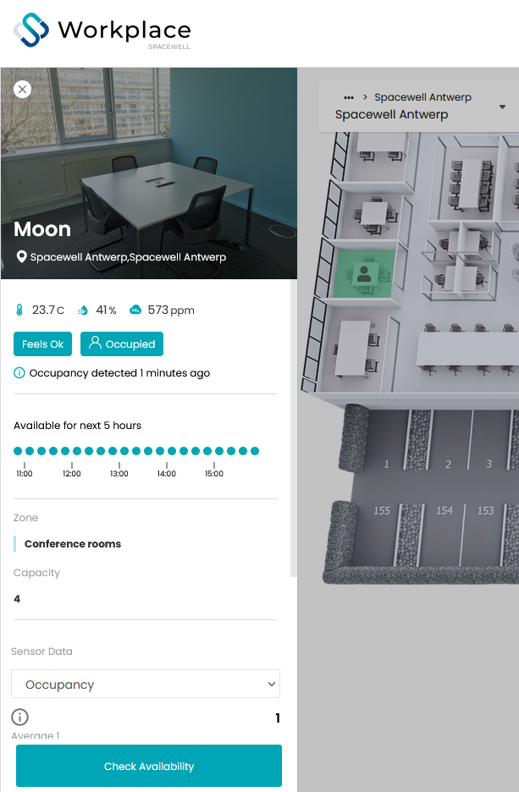
Location Detail Screen
Location name & Picture
Comfort & Occupancy information
Linked zone & department
Capacity
Latest Sensor data shows timelines in a graphical representation for current day and the past 1 month.
Select a specific type of sensor data from the dropdown list or click the "Show all" button to see different types of captured sensor data for this location.
"Show all" Data automatically shows Today, but it's possible to select a date from max 1 month in the past through the calendar
Check Availability button will open a calendar view, allowing you to make a reservation

Slide 8
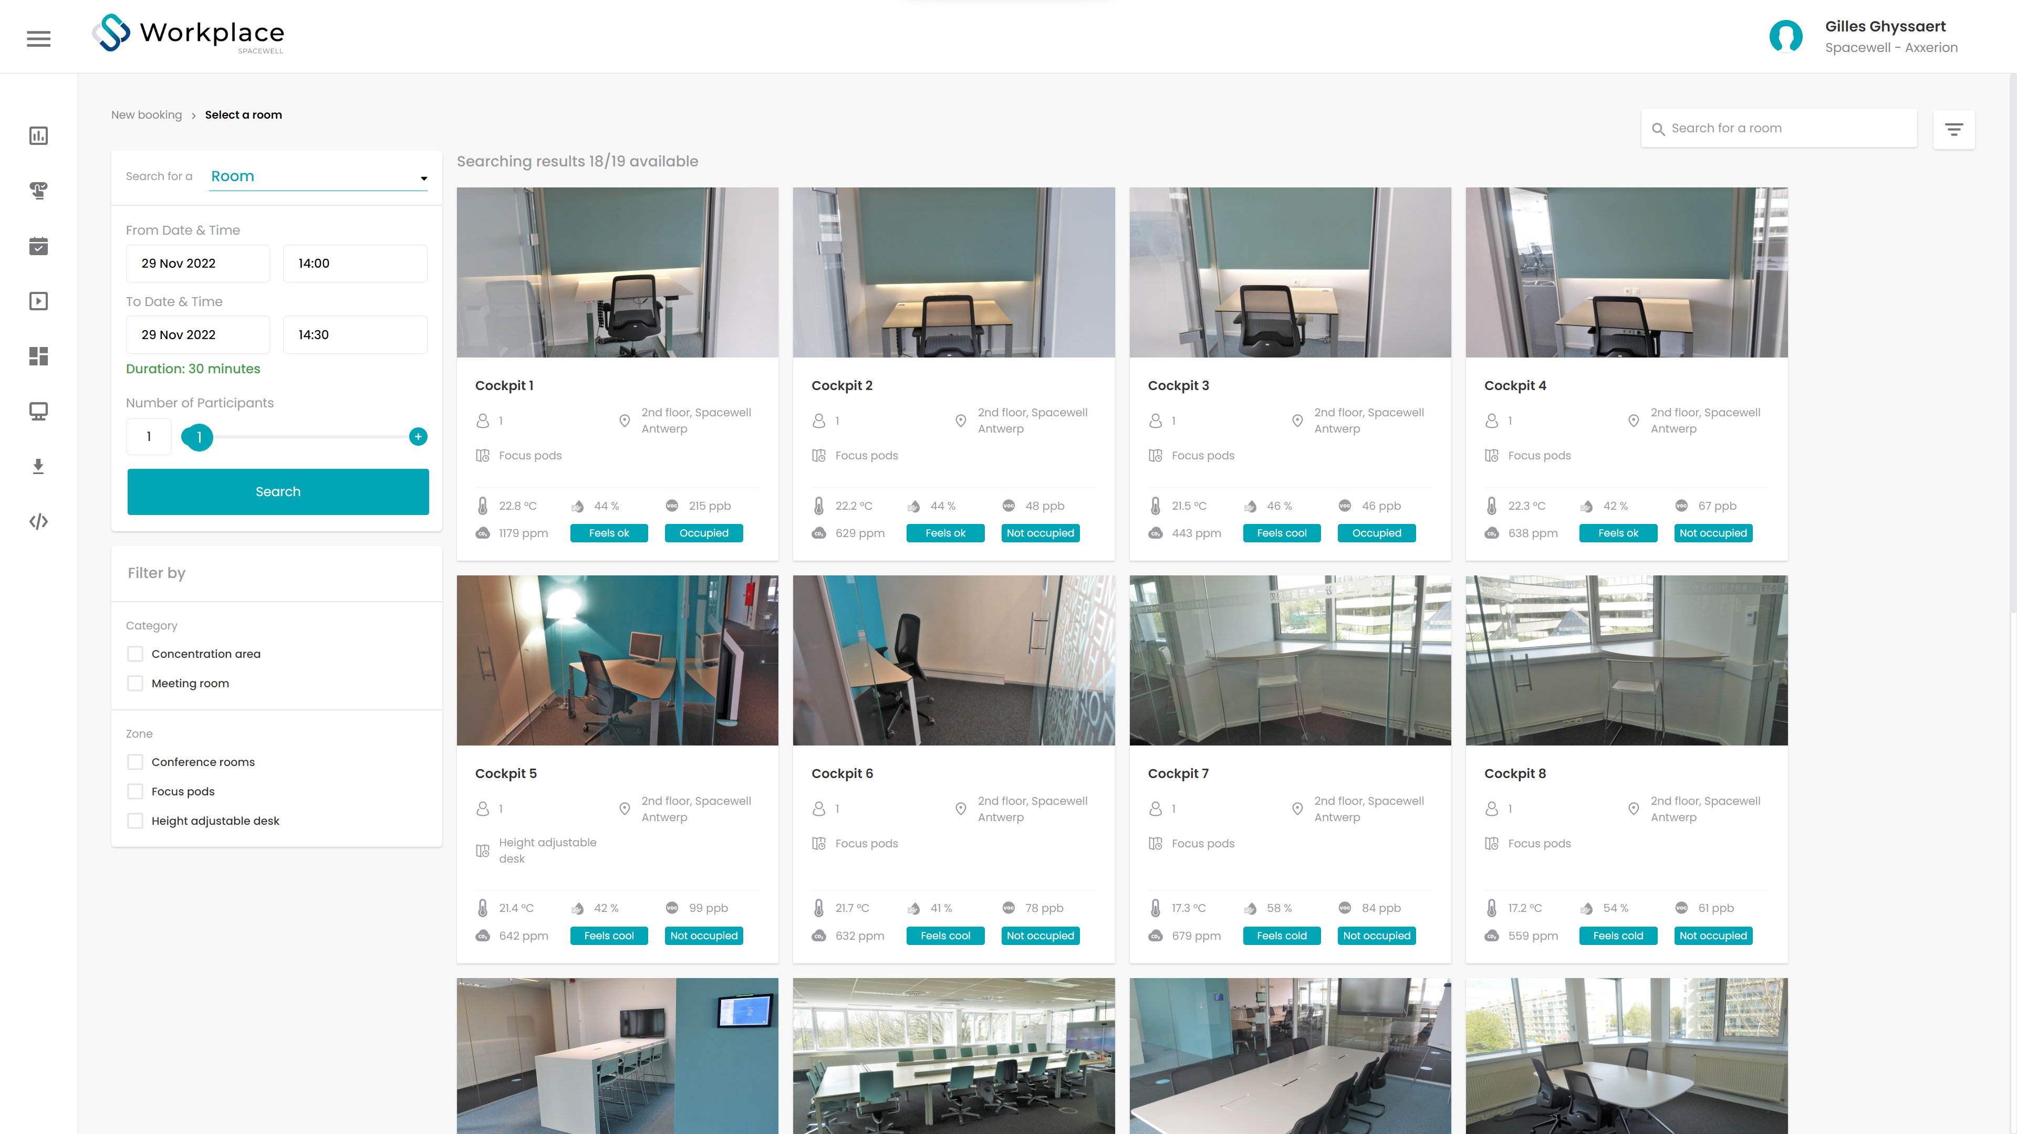
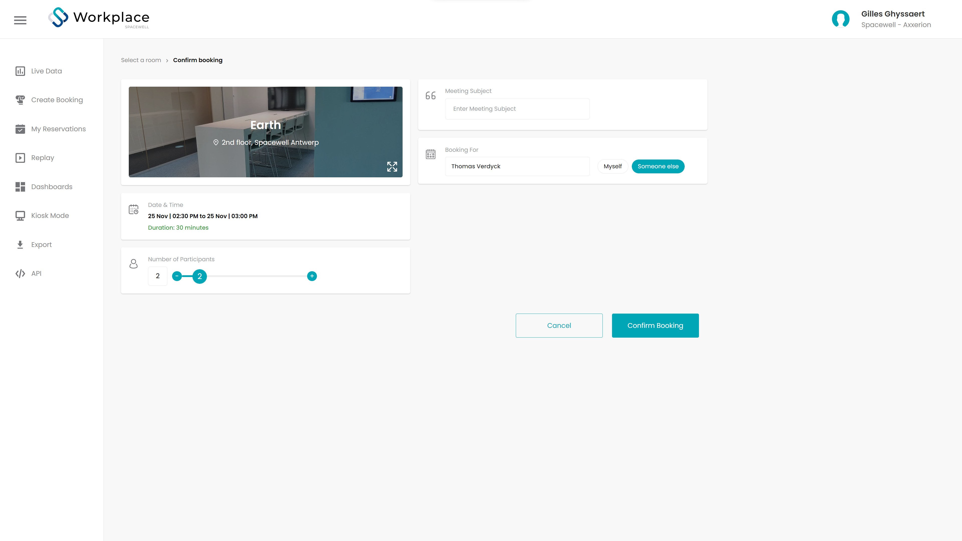
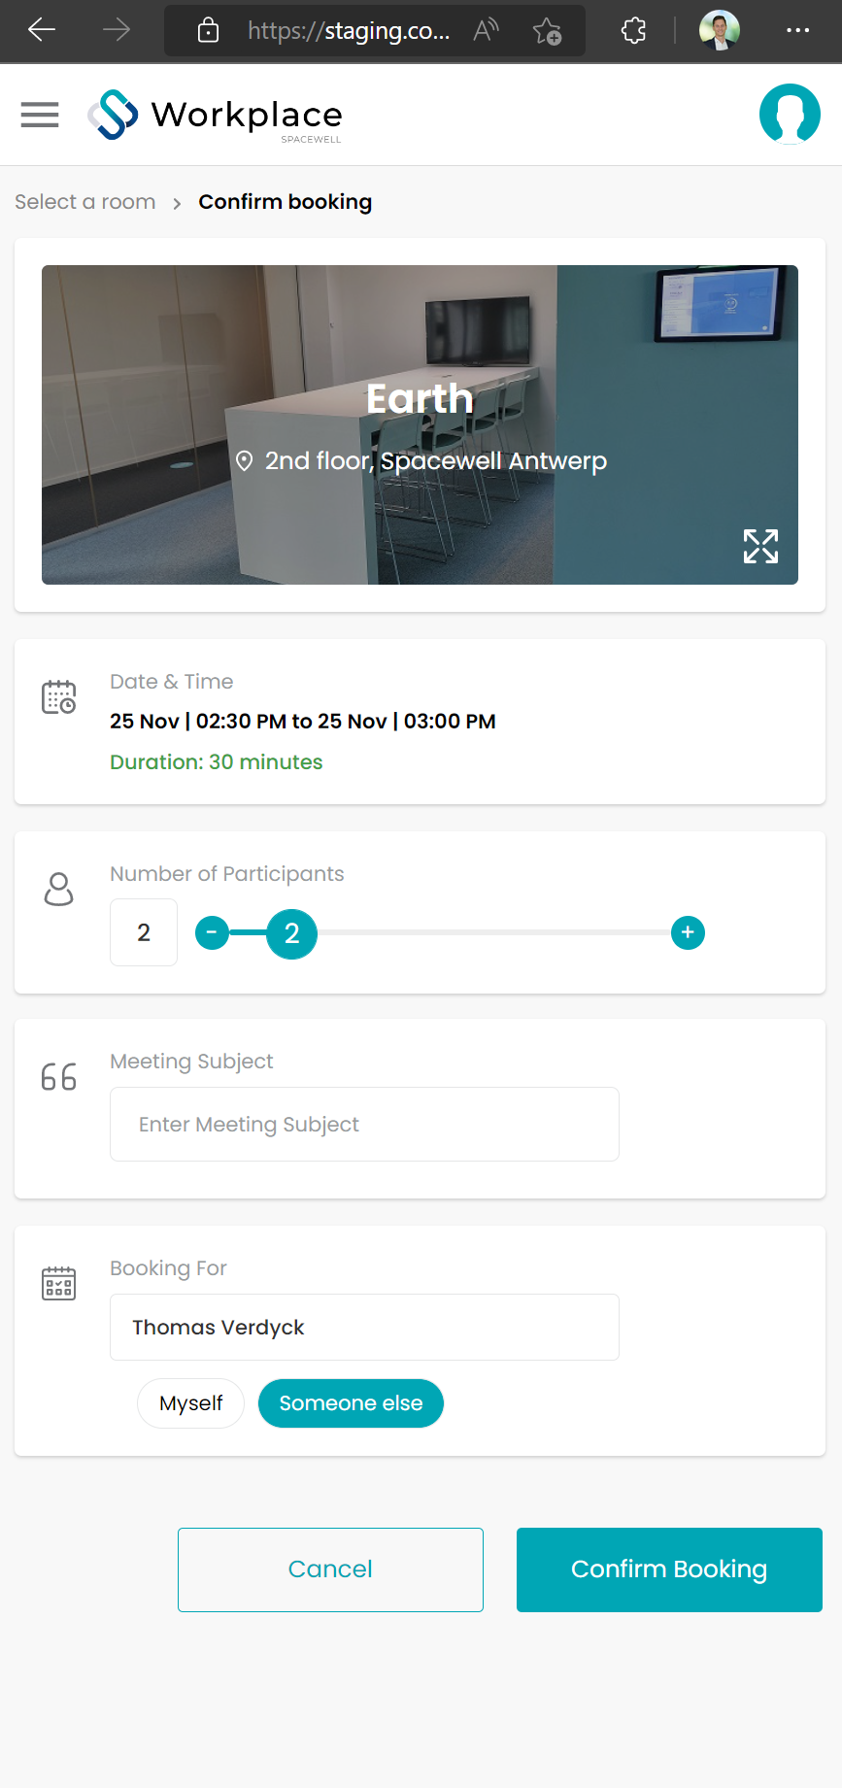
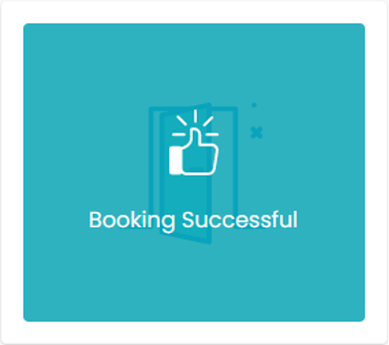

BOOKINGS MADE EASY in Create Booking
Based on date/time & nr of participants search > Search Results contain more info about locations
Select location
Confirm Date & Time,
Add description and reservation responsible
Confirm booking
All done!

Slide 9
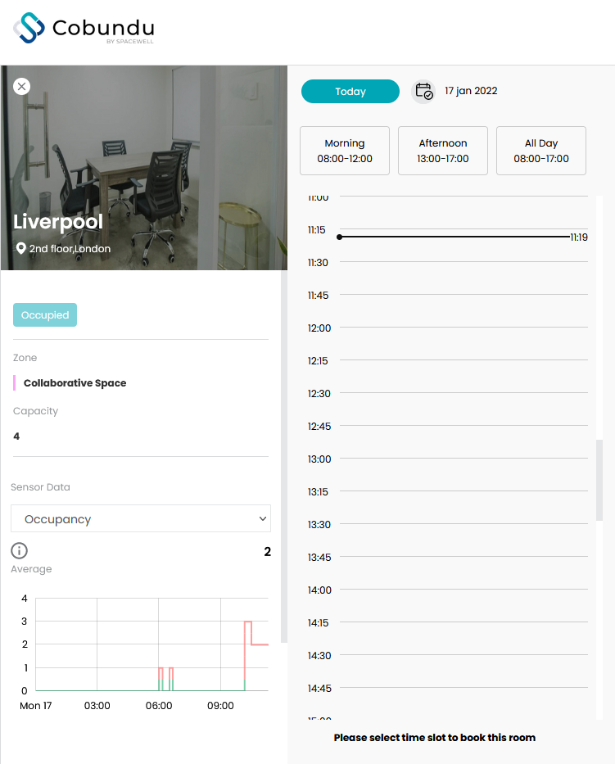
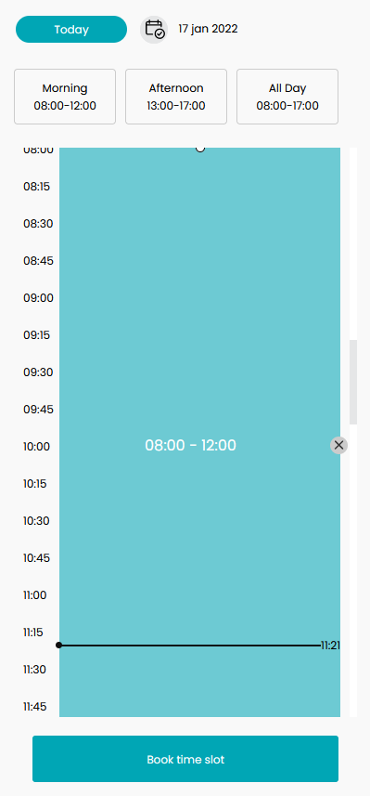
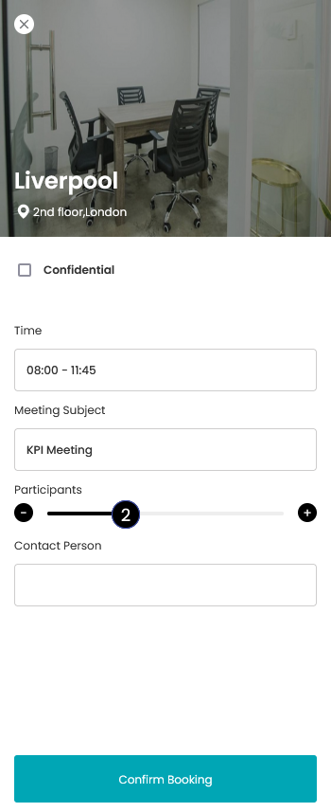
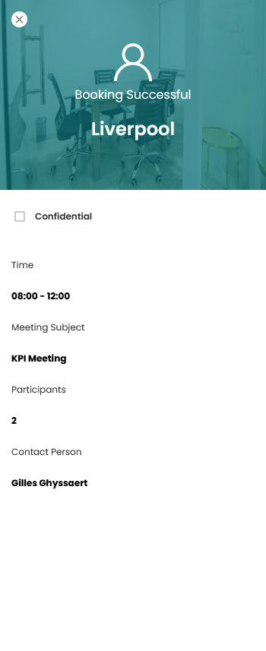
BOOKINGS MADE EASY on Live Data Floor plan
Select a location
> Check Availability
Select date & time
Today or via calendar
Use Quick Timeslots or select timeframe
Confirm timeslot
Confirm booking
All done!

Slide 10
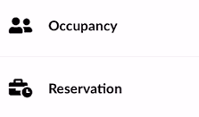
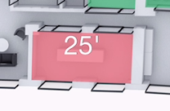

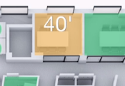
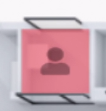
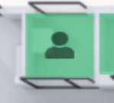


LEGEND
Floorplan - Reservation View
Floorplan - Occupancy View
Red means the room is reserved and occupied.
The number indicates for how long the room is reserved in minutes.
Green means that the location is not currently occupied.
Yellow means the room is reserved but not currently occupied. After a certain time limit, a room in this state will be freed-up.
Red means the room/desk is currently occupied. The icon will fade out over time. As the icon fades out, the likelihood that the room is still occupied is going down. After a sensor is triggered, it takes 15 minutes for the location to show green again (if not triggered again)
Green with an icon means the room is not reserved but occupied.
Green with a number means the room is reserved in X minutes.
Grey means that this location should not be used/ occupied (eg checkered pattern due to covid).
Red with an icon means that the room is not reservable but currently occupied.

Slide 11
THANK
YOU

